Slide 1



School of Information Technology
https://www.monash.edu.my/
FIT5226
Multi-agent System & Collective Behaviour
Week 6: Classical Game Theory (Nash)
FIT5226-S2-2024
Prepared by: Bernd Meyer. Edited by: Fuad Noman
www.monash.edu.au
Notes:
Classical Game Theory is the study of strategic decision-making, where multiple players make choices to maximize their outcomes. A Nash Equilibrium occurs when no player can improve their payoff by unilaterally changing their strategy, assuming all other players stick to their chosen strategies. In this equilibrium, every player’s strategy is optimal given the strategies of others. Developed by John Nash, this concept applies to a wide range of scenarios, including economics, politics, and biology, where participants' actions affect each other’s outcomes.

Slide 2
Acknowledgements
This material includes content adapted from instructional resources made available by the authors of our main textbook, Chapter 3 “Multiagent Systems”, Yoav Shoham and Kevin Leyton-Brown, Cambridge University Press, 2009.

Slide 3
Individual vs Collective Perspective
From the outside all agent’s interests are equally important.
What does this mean for outcomes*
that differ only on the individual level ?
The problem is to find a way of saying that some outcomes are better than others
*The outcome of a game represents the specific combination of strategies chosen by all players, which in turn leads to a set of payoffs for each player based on the rules of the game and the interactions between the players.
FIT5226-S2-2024
3/46
Notes:
Lets consider a real-world example where an external observer values the interests of all parties equally and seeks fair outcomes: Labor Negotiations in a Company.
Scenario: A company is negotiating a new labor contract with its employees, represented by a labor union. The negotiations involve various issues, including wages, working conditions, and benefits.
External Observer Perspective: In this scenario, the external observer could be a mediator, government agency, or public opinion. They view the interests of both the company and the employees as equally important and aim to ensure fairness in the negotiation outcomes.
Example Outcomes:
Scenario A - Wage Increase: The company agrees to a substantial wage increase for the employees, which is beyond what they initially proposed. The employees, in turn, accept some changes in working conditions that the company considered important.
External Observer Assessment: From the external observer's perspective, this outcome may be viewed as fair because it addresses the financial needs of the employees while also recognizing the company's concerns about productivity and costs.
Scenario B - Compromise on Benefits: The negotiation results in a compromise where both parties agree to maintain current wage levels but improve employee benefits such as healthcare and retirement plans.
External Observer Assessment: This outcome may be seen as equitable since it provides tangible benefits to employees without significantly increasing labor costs for the company, maintaining a balanced approach.
Scenario C - Deadlock: The negotiations reach a deadlock, and neither party reaches an agreement. As a result, the existing labor contract continues without any changes.
External Observer Assessment: While this outcome may not provide any immediate benefits or changes, the external observer may view it as fair because it ensures that neither party gains an unfair advantage over the other.
In these scenarios, the external observer's role is to ensure that the interests of both the company and the employees are treated with equal importance. They aim to foster fairness, avoid exploitation, and maintain a balance of power during the negotiation process. The specific outcome that is considered fair may vary depending on the circumstances, but the observer's objective is to prevent one party from consistently benefiting at the expense of the other.

Slide 4
Collective Perspective: Pareto Optimality
If an outcome o′ is at least as good as another outcome o
for all agents but there is at least one agent who strictly prefers
o′ to o, we say that o′ pareto dominates o.
An outcome o* is pareto optimal if no other outcome o
pareto dominates it.
Does every game have a pareto optimal outcome?
Can there be multiple pareto optimal outcomes?
FIT5226-S2-2024
4/46
Notes:
Pareto Optimality:
Pareto optimality, also known as Pareto efficiency or Pareto superiority, refers to a situation in which it is not possible to make any one individual better off without making at least one other individual worse off.
In other words, a state or outcome is Pareto optimal when there is no way to improve the well-being or utility of one player without reducing the well-being or utility of another player.
Pareto optimality is a desirable state because it represents a point where resources are allocated efficiently, and no further changes can be made to benefit one player without harming another.
Pareto Domination:
Pareto domination, on the other hand, is a comparison between two outcomes in a game.
An outcome is said to Pareto dominate another outcome if it is at least as good for all players and strictly better for at least one player. In this case, one outcome is better in some way without making any player worse off.
Pareto domination is a way to compare the desirability of different outcomes within a game.
Conclusion:
First, every game must have at least one such optimum, and there must always exist at least one such optimum in which all players adopt pure strategies.
Second, some games will have multiple optima. For example, in zero-sum games, all strategy profiles are strictly Pareto efficient.
Finally, in common-payoff games, all Pareto optimal strategy profiles have the same payoffs.

Slide 5
Pareto Optimality Example
L
R
L R
1,1 | 0,0
0,0 | 1,1
multiple Pareto optimal outcomes
Traffic Game
FIT5226-S2-2024
5/46
Notes:
imagine two drivers driving towards each other in a country having no traffic rules, and who must independently decide whether to drive on the left or on the right. If the drivers choose the same side (left or right) they have some high utility, and otherwise they have a low utility

Slide 6
Pareto Optimality Example
B
F
multiple Pareto optimal outcomes
BF
2, 1 | 0, 0
0, 0 | 1, 2
The highlighted outcomes are Pareto optimal because there is no way to make one player better off without making the other worse off.
In both cases, both players are as well off as they can be given their preferences and the available options.
Battle of the Sexes
FIT5226-S2-2024
6/46
Notes:
Battle of the Sexes, a Sexes game husband and wife wish to do some sport exercise, and they can select among two options:
“Bayley“ or “Football”. They much prefer to go together rather than to separate movies, but while the wife (player 1) prefers B, the
husband (player 2) prefers F.

Slide 7
Pareto Optimality Example
H
T
HT
1, -1 | -1, 1
-1, 1 | 1, -1
Non of the outcomes are dominated.
The whole is called Pareto optimal
In the context of Pareto optimality, if an outcome is dominated by another outcome, it is typically excluded from being considered Pareto optimal.
Matching Pennies
FIT5226-S2-2024
7/46
Notes:
The payoffs are assigned based on the following logic:
If both players choose the same side (both heads or both tails), Player 1 wins, and Player 2 loses. The payoffs are (1, -1) for Player 1 and (-1, 1) for Player 2.
If the players choose different sides, Player 2 wins, and Player 1 loses. The payoffs are (-1, 1) for Player 1 and (1, -1) for Player 2.
None of the outcomes are Pareto optimal. Pareto optimality implies that there is no other outcome in the game that is at least as good for all players and strictly better for at least one player

Slide 8
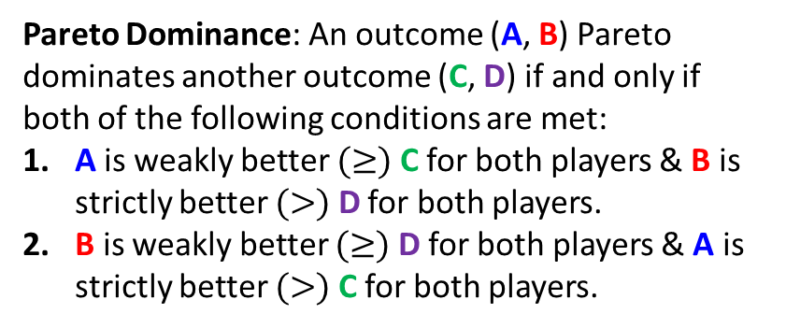
Pareto Optimality Example
Pareto Dominance: An outcome (A, B) Pareto dominates another outcome (C, D) if and only if both of the following conditions are met:
A is weakly better $(≥)$ C for both players & B is strictly better $(>)$ D for both players.
B is weakly better $(≥)$ D for both players & A is strictly better $(>)$ C for both players.
C
D
C D
-1, -1 | -4, 0
0, -4 | -3, -3
(D, D) is the only Pareto-dominated outcome, hence the only non-Pareto-optimal outcome.
Prisoners’ dilemma: TCP Backoff Games
recall that “X is pareto optimal” does not mean its pareto-dominant but that it is not pareto-dominated
FIT5226-S2-2024
8/46
Notes:
Consider this situation as a two-player game:
both use a correct implementation: both get 1 ms delay
one correct, one defective: 4 ms delay for correct, 0 ms for defective
both defective: both get a 3 ms delay.
Pareto Dominance: In other words, an outcome (A, B) Pareto dominates another outcome (C, D) if it is at least as good as the other outcome for both players, and it is strictly better (greater) for at least one player. This ensures that no player is worse off, and at least one player is better off in the Pareto dominant outcome.
(-1, -1) is not Pareto dominated by any other outcomes.
(-4, 0) is not Pareto dominated by any other outcomes.
(0, -4) is not Pareto dominated by any other outcomes.
(-3, -3) is Pareto dominated by (-1, -1) because (-1, -1) is strictly better for both players (they both receive a higher payoff in (-1, -1)).

Slide 9
Pareto Optimality
A
B
C
D
A
B
C
D
C dominates A (A is dominated)
A
B
C
D
D dominates B (B is dominated)
A
B
C
D
B dominates C (C is dominated)
Can there be a game with no Pareto-optimal outcome?
The outcome that is not dominated, is Pareto optimal
FIT5226-S2-2024
9/46
Notes:
No, every game has at least one Pareto-optimal outcome. A Pareto-optimal outcome is one in which no player can be made better off without making another player worse off. However, this does not imply that every game has an efficient or desirable outcome for all players. In some games, achieving a Pareto-optimal outcome may still result in significant inequalities or dissatisfaction for some participants. But there will always be some point in the game where no further improvements can be made for any player without harming others.

Slide 10
Outcomes from the individual Perspective
Now let’s consider what is best for one individual player.
FIT5226-S2-2024
10/46

Slide 11
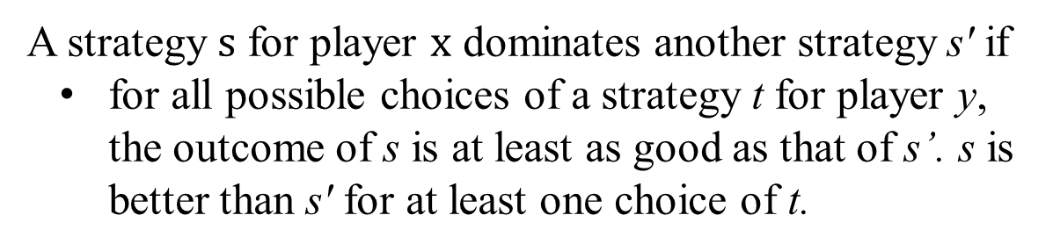
A strategy $s$ for player $x$ dominates another strategy s' if
for all possible choices of a strategy t for player y, the outcome of s is at least as good as that of s’. s is better than s' for at least one choice of t.
Assume the following pay-0ff matrix:
 | t₁ | t₂ | t₃ | t₄
s₁ | -2 | 2 | -1 | 1
s₂ | 1 | 4 | -2 | -3
s₃ | 0 | 2 | 0 | 1
s₄ | -1 | -2 | -1 | 5
A rational player will never play a dominated strategy
FIT5226-S2-2024
11/46
Notes:
If row n dominates row m (excluded strategy/ row).
If any row/strategy is not dominated by any other row/strategy (better)

Slide 12
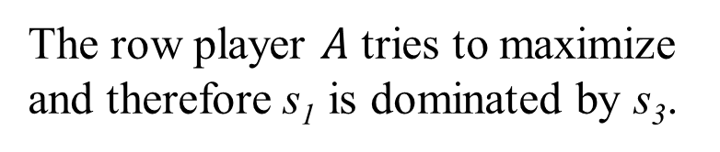

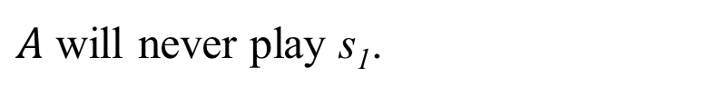
The row player $A$ tries to maximize and therefore s₁ is dominated by s₃.
$A$ will never play s₁.
player $B?$
 | t₁ | t₂ | t₃ | t₄
s₁ | -2 | 2 | -1 | 1
s₂ | 1 | 4 | -2 | -3
s₃ | 0 | 2 | 0 | 1
s₄ | -1 | -2 | -1 | 5
 | t₁ | t₂ | t₃ | t₄
s₁ | -2 | 2 | -1 | 1
s₂ | 1 | 4 | -2 | -3
s₃ | 0 | 2 | 0 | 1
s₄ | -1 | -2 | -1 | 5
FIT5226-S2-2024
12/46

Slide 13
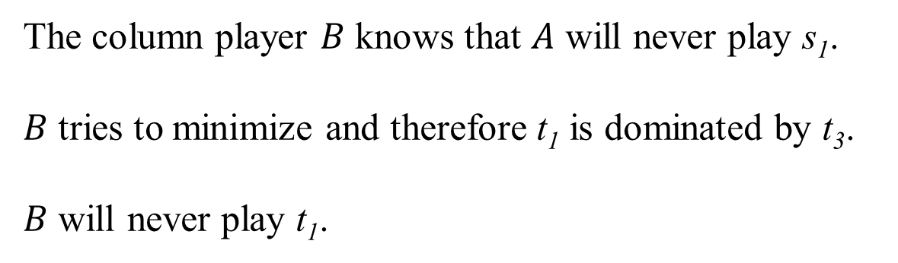
The column player $B$ knows that $A$ will never play s₁.
$B$ tries to minimize and therefore t₁ is dominated by t₃.
$B$ will never play t₁.
 | t₁ | t₂ | t₃ | t₄
s₁ | -2 | 2 | -1 | 1
s₂ | 1 | 4 | -2 | -3
s₃ | 0 | 2 | 0 | 1
s₄ | -1 | -2 | -1 | 5
Remember, the values in the table is the payoff of player A.
So, for player B, more negative is better.
This is called the Best Response (if A knows what B playing, pick the best response)
FIT5226-S2-2024
13/46
Notes:
What happens:
If player A (rows) plays S3, B plays t3 (0 at the cross of t3, S3: lose 0 coins at the cell 3,3)
If player A plays S2, B plays t4 (-3 at the cross of t4, S2: make A lose 3 coins)
This is called the Best Response (if A knows what B playing, pick the best response)

Slide 14

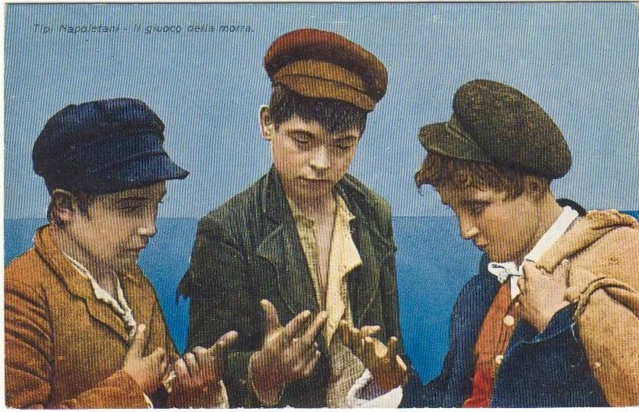
Morra
Each Player hides one or two coins.
Each player guesses how many coins the opponent has hidden.
There is a win if and only if one player guesses correctly, the other one incorrectly.
In case of a win, an amount equal to the total number of hidden coins is paid to the winner.
FIT5226-S2-2024
Week-7
Notes:
The key strategic element in this game is the decision to hide either one or two coins and the subsequent guess based on what the opponent might have done. Players need to consider their opponent's possible choices and use randomization to make their guesses less predictable.
For example, if a player always hid and guessed two coins, the opponent could exploit this by always hiding and guessing one coin. To counteract this, players might randomize their choices, such as hiding one coin half the time and two coins the other half, and making corresponding guesses.
The concept of mixed strategy Nash equilibrium comes into play when players choose to randomize their actions to make it difficult for the opponent to exploit a predictable pattern. In equilibrium, neither player has an incentive to unilaterally deviate from their strategy, given the strategy of the opponent.
This game highlights the strategic interplay between hiding, guessing, and randomizing choices. It's a simple yet illustrative example of the complexities that can arise in competitive decision-making when hidden information is involved.

Slide 15
Morra Payoff Matrix
Strategies for both players:
 |  |  | (1/ 1) | (1/ 2) | (2 /1) | (2 / 2)
(1/1) | Hide one coin, guess “one coin” | (1 /1) | 0 | 2 | −3 | 0
(1/2) | Hide one coin, guess “two coins” | (1/ 2) | −2 | 0 | 0 | 3
(2/1) | Hide two coins, guess “one coin” | (2 / 1) | 3 | 0 | 0 | −4
(2/2) | Hide two coins, guess “two coins” | (2 / 2) | 0 | −3 | 4 | 0
As this is zero-sum, a single matrix is enough to denote the outcomes (instead of a bi-matrix notation, i.e. (m, n))
We speak of the “column player” and the “row player”.
the pay-off is given for the row player (by convention)
the row player tries to maximize the outcome
column player tries to minimize the outcome
Notes:
The key strategic element in this game is the decision to hide either one or two coins and the subsequent guess based on what the opponent might have done. Players need to consider their opponent's possible choices and use randomization to make their guesses less predictable.
For example, if a player always hid and guessed two coins, the opponent could exploit this by always hiding and guessing one coin. To counteract this, players might randomize their choices, such as hiding one coin half the time and two coins the other half, and making corresponding guesses.
The concept of mixed strategy Nash equilibrium comes into play when players choose to randomize their actions to make it difficult for the opponent to exploit a predictable pattern. In equilibrium, neither player has an incentive to unilaterally deviate from their strategy, given the strategy of the opponent.
This game highlights the strategic interplay between hiding, guessing, and randomizing choices. It's a simple yet illustrative example of the complexities that can arise in competitive decision-making when hidden information is involved. In this matrix:
The rows represent the player's choices for hiding coins.
The columns represent the player's choices for guessing the opponent's hidden coins.
The values in the matrix represent the payoffs for the player who guesses.
For example, if the player hides 1 coin and guesses that the opponent hides 2 coins, the payoff for the guessing player would be 3.
This matrix can be used to analyze the game using various game theory concepts, such as Nash equilibrium. Players will aim to choose strategies that maximize their expected payoffs while considering their opponent's possible actions. They might use mixed strategies (randomized choices) to create unpredictability and gain a strategic advantage.
In the provided matrix, the entry at the intersection of row (1/1) and column (1/1) indeed shows a payoff of 0. This indicates that when both players choose to hide 1 coin and both players guess that the opponent has hidden 1 coin, the game results in a tie, and neither player wins or loses any amount.
This makes sense in the context of the game. If both players have the same number of hidden coins and both players guess the same number of coins, then their guesses are correct, and there's no net payoff for either player. It's a situation where neither player gains an advantage over the other.
The 0 payoff in this case highlights the equilibrium between the choices made by both players. It's a reflection of the symmetric nature of the game, where both players have the same information and both have an equal chance of winning or losing based on their guesses.

Slide 16
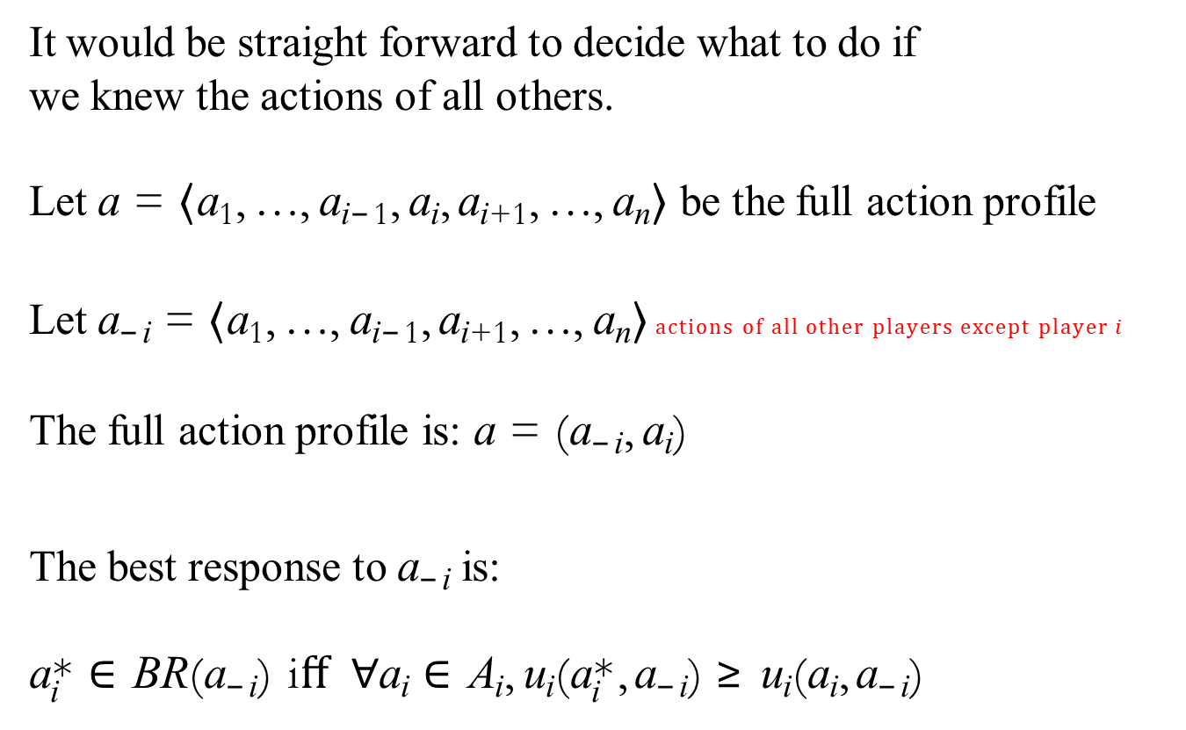
Best Response (BR)
It would be straight forward to decide what to do if we knew the actions of all others.
Let a = ⟨a₁, …, a_{i−1}, a_{i}, a_{i+1}, …, a_{n}⟩ be the full action profile
Let a_{−i} = ⟨a₁, …, a_{i−1}, a_{i+1}, …, a_{n}⟩ actions of all other players except player $i$
The full action profile is: a = (a_{−i}, a_{i})
The best response to a_{−i} is:
a_{i}* ∈ BR(a_{−i}) iﬀ ∀a_{i} ∈ A_{i}, u_{i}(a_{i}*, a_{−i}) ≥ u_{i}(a_{i}, a_{−i})
FIT5226-S2-2024
16/46
Notes:
a_{i}* ∈ BR(a_{−i}): This part means that action $a_{i}$belongs to the best response of player $i$ (BR) given the actions $a_{−i}$
a_{i}*: is the action that player $i$would choose as the best response to the actions of all other players.
∀a_{i} ∈ A_{i}: This part indicates that the statement applies for all possible actions $a_{i}$ in the action set $A_{i}$of player $i$.
u_{i}(a_{i}*, a_{−i}) ≥ u_{i}(a_{i}, a_{−i}): This part is the condition for being a best response. It means that the utility (payoff) of player $i$receives from choosing action $a_{i}^{∗}$when all other players play $a_{−i}$is greater than or equal to the utility player $i$ receives from choosing action ai when all other players play$a_{−i}$. In simpler terms, player $i$ will choose $a_{i}^{∗}$if it leads to an outcome that is at least as good as (or better than) choosing $a_{i}$.

Slide 17
Players in equilibrium
If no player has a unilateral incentive to change their strategy,
we say that players use strategies in equilibrium
Formally, in a game with multiple players, a Nash Equilibrium is a set of strategies (one for each player) where no player can improve their own payoff by unilaterally changing their strategy while keeping the strategies of all other players fixed.
FIT5226-S2-2024
17/46
Notes:
If no player in a game has a reason to change their strategy on their own (because doing so wouldn't give them a better result), then we say that the players are using strategies that are in balance or in harmony with each other. This is called an equilibrium. In chess, if both players reach a point in the game where neither player can improve their position or gain an advantage by changing their strategy, then they are in equilibrium. For example, in some endgame positions, both players might recognize that any move they make will not change the outcome (like a draw), so they continue to play the same strategy, leading to a stalemate.
This situation in chess is similar to what is described as "strategies in equilibrium" in game theory. Neither player has a unilateral incentive to change their move because it wouldn’t improve their situation.

Slide 18
Nash Equilibrium
Nash Equilibrium (saylordotorg.github.io)
But we don’t know what the others will do, and their decisions depend on mine!
However, a situation is stable if every player is playing their best response to all other players.
a = (a₁, …, a_{n}) is a Nash Equilibrium (in pure strategies) iff
∀i, a_{i} ∈ BR(a_{−i})
Note: at this point, we only care about pure strategies.
FIT5226-S2-2024
18/46
Notes:
a = (a1, …, an): This represents a profile of strategies for all players in the game. Each ai represents the action chosen by player i.
a is a Nash Equilibrium: This part asserts that the action profile a is indeed a Nash Equilibrium.
∀i, ai ∈ BR(a−i): This is the core condition for Nash Equilibrium. It states that for every player i in the game, the action ai chosen by that player must belong to their best response set BR(a−i), which is the set of actions that player i considers as a best response to the actions of all other players (a−i).
A pure strategy represents a deterministic plan of action, where a player selects a single, precise choice from their strategy set without any randomness or uncertainty.

Slide 19

Saddle Points
How to choose a strategy (after removing the dominated ones)?? Maximize the worst case!
A reasonable way to do this for player row player A is to calculate the minimum pay-off for each possible strategy choice $s_{i}$ (assuming that B would react with this choice in the worst case) and to choose the $s_{i}$ that maximizes this minimum expected pay-off.
B would do the same swapping minimization and maximization.
If A starts to play $s_{3}$ (or B $t_{3}$) the other player is forced to choose $t_{3}$ ($s_{3}$) since the expected pay-off is worse otherwise. Such a stable point is called a saddle point.
A saddle point is a pair of strategies such that there is no lower pay-off in the row and no higher pay-off in the column.
 | t₁ | t₂ | t₃ | t₄
s₁ | -2 | 2 | -1 | 1
s₂ | 1 | 4 | -2 | -3
s₃ | 0 | 2 | 0 | 1
s₄ | -1 | -2 | -1 | 5
FIT5226-S2-2024
19/46
Notes:
Just look at the last two statements to define the saddle points.

Slide 20
Nash Equilibrium Example
L
R
L R
1,1 | 0,0
0,0 | 1,1
Multiple Nash Equilibria
Traffic Game
FIT5226-S2-2024
20/46
Notes:
The traffic game described has two players choosing between Left (L) or Right (R)
In this scenario:
There are two pure Nash equilibria: (L,L)(L, L)(L,L) and (R,R)(R, R)(R,R), where both players coordinate on either Left or Right, earning (1, 1).
No player has an incentive to deviate from these equilibria because doing so results in a payoff of 0 for both.

Slide 21
Nash Equilibrium Example
B
F
B F
2, 1 | 0, 0
0, 0 | 1, 2
Multiple Nash Equilibria
Battle of the Sexes
FIT5226-S2-2024
21/46
Notes:
Understanding Nash Equilibrium
A Nash Equilibrium occurs when neither player can improve their payoff by unilaterally changing their strategy, given the other player's strategy.
Multiple Nash Equilibria in the Battle of the Sexes
This game has two pure strategy Nash equilibria and one mixed strategy Nash equilibrium:
1. (B, B) - Pure Strategy Nash Equilibrium
If Player 1 chooses B and Player 2 also chooses B, then neither player has an incentive to change their strategy. Player 1 gets 2 (their highest possible payoff), and Player 2 gets 1.
If Player 2 switches to F, they would get 0 instead of 1, which is worse for them. Similarly, Player 1 wouldn't want to switch to F either because they would get 0 instead of 2.
2. (F, F) - Pure Strategy Nash Equilibrium
If Player 1 chooses F and Player 2 also chooses F, again, neither player has an incentive to change their strategy. Player 1 gets 1, and Player 2 gets 2 (their highest possible payoff).
If Player 2 switches to B, they would get 0 instead of 2, which is worse for them. Similarly, Player 1 wouldn't want to switch to B because they would get 0 instead of 1.
3. Mixed Strategy Nash Equilibrium
In the mixed strategy Nash equilibrium, each player randomizes between B and F with certain probabilities. The idea is that each player is indifferent to the strategy choices of the other player, and this indifference is maintained by randomizing their own choices.
To calculate the exact probabilities, you would set up equations that equalize the expected payoffs for each player, given the mixed strategies of the other player. However, the existence of a mixed strategy equilibrium demonstrates that there can be additional equilibria beyond the pure strategy ones.
Why Multiple Equilibria?
Coordination Problem: The game reflects a coordination problem where both players want to coordinate but have different preferences. The multiple equilibria represent the different ways coordination can happen (either both choose B or both choose F).
Different Preferences: The multiple Nash equilibria show that depending on which equilibrium they coordinate on, one player may end up better off than the other.
In summary, the Battle of the Sexes game has multiple Nash equilibria because there are different ways in which the players can coordinate their strategies to achieve mutual benefit, with each equilibrium reflecting a different outcome that aligns with one of the player's preferences.

Slide 22
Nash Equilibrium Example
C D
C
D
Prisoners’ dilemma
The paradox of Prisoner’s dilemma: the Nash equilibrium is the only non-Pareto-optimal outcome!
(D, D) is the only Pareto-dominated outcome, hence the only non-Pareto-optimal outcome.
­-1, ­-1 | -­4, 0
0, ­-4 | -­3,- ­3
Nash Equilibrium is a concept in game theory that describes a stable state in which no player has an incentive to unilaterally change their strategy, given the strategies chosen by the other players.
FIT5226-S2-2024
22/46
Notes:
Player | curr strategy | next strategy | reason
-----------------------------------------------------------
Row | CC | DC | 0 > -1
-----------------------------------------------------------
Row | DC | None | -1 < 0
-----------------------------------------------------------
Row | CD | DD | -3 > -4
-----------------------------------------------------------
Row | DD | None | -3 < -4
-----------------------------------------------------------
Col | CC | CD | -1 > 0
-----------------------------------------------------------
Col | CD | None | -1 < 0
-----------------------------------------------------------
Col | CD | DD | -3 > -4
-----------------------------------------------------------
Col | DD | None | -3 < -4
-----------------------------------------------------------

Slide 23
Nash Equilibrium Example
H T
H
T
1,-1 | -1,1
-1,1 | 1,-1
Matching Pennies
FIT5226-S2-2024
23/46
Notes:
The Matching Pennies game has two players who each choose heads (H) or tails (T). This game has no pure strategy Nash equilibrium because both players have opposing interests—when one wins, the other loses. However, there is a mixed strategy Nash equilibrium, where both players randomize their choices. The equilibrium is when each player chooses heads or tails with a probability of 50%, ensuring no player can predict the other's move and gain an advantage.

Slide 24
Nash Equilibrium Example
H T
H
T
Can you play a deterministic strategy in this game? (eg “always heads”)
Leave your opponent in the dark by playing randomly!
1,-1 | -1,1
-1,1 | 1,-1
No Nash Equilibria
FIT5226-S2-2024
24/46
Notes:
In the Matching Pennies game, playing a deterministic strategy, such as always choosing heads (H), is not optimal. If one player always plays a fixed strategy (e.g., always heads), the other player can exploit this by always choosing tails (T) and win every round. This makes deterministic strategies vulnerable. The best approach for both players is to play a mixed strategy, where each chooses heads or tails randomly with a probability of 50%, making it impossible for the opponent to predict and exploit.
Yes, you can leave your opponent in the dark by playing randomly in the Matching Pennies game. By using a mixed strategy, where you randomly choose heads or tails with a 50% probability, your opponent cannot predict your next move. This randomness eliminates any pattern that could be exploited. Since the game’s structure relies on opposing interests, playing randomly ensures that your opponent can't gain a consistent advantage and both players remain in an uncertain strategic situation.

Slide 25
Strategy Profiles
Define a strategy s_{i} for agent i as any probability distribution over the actions A_{i}
pure strategy: only one action is played with positive probability
mixed strategy: more than one action is played with positive probability
These actions are called the support of the mixed strategy
Let the set of all strategies for i be S_{i}
Let the set of all strategy profiles be S = S₁ × … × S_{n}
FIT5226-S2-2024
25/46
Notes:
Pure strategy: A pure strategy is a specific, deterministic plan of action in which a player selects a single, well-defined choice from their strategy set. It represents a single, definite decision without any randomness or uncertainty.
Mixed strategy: A mixed strategy is a probabilistic plan of action in which a player selects strategies from their strategy set with associated probabilities. It involves randomization and represents a distribution of choices over a range of strategies. Matching Pennies Example: 1. Pure Strategy
A pure strategy is where a player always chooses the same action. For instance:
Player A: Always chooses Heads.
Player B: Always chooses Tails.
In this case:
Player A's pure strategy is (H, 0), meaning they choose Heads with probability 1 and Tails with probability 0.
Player B's pure strategy is (0, T), meaning they choose Heads with probability 0 and Tails with probability 1.
2. Mixed Strategy
A mixed strategy is where a player assigns a probability to each action, playing each with a positive probability. For example:
Player A: Chooses Heads with probability 0.5 and Tails with probability 0.5.
Player B: Chooses Heads with probability 0.7 and Tails with probability 0.3.
In this case:
Player A's mixed strategy is (0.5, 0.5).
Player B's mixed strategy is (0.7, 0.3).
3. Support of a Mixed Strategy
The support of a mixed strategy consists of the actions that are played with positive probability.
For Player A: The support of their mixed strategy is {H, T} because both actions are chosen with positive probability (0.5 each).
For Player B: The support of their mixed strategy is also {H, T} since both actions are chosen with positive probabilities (0.7 and 0.3).
Summary
Pure Strategy: The player consistently chooses one action (e.g., always Heads).
Mixed Strategy: The player assigns probabilities to multiple actions (e.g., 0.5 Heads and 0.5 Tails).
Support: The set of actions that have a positive probability in a mixed strategy (e.g., both Heads and Tails for Player A).

Slide 26
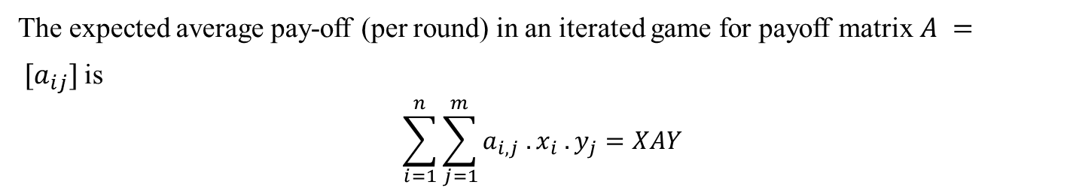
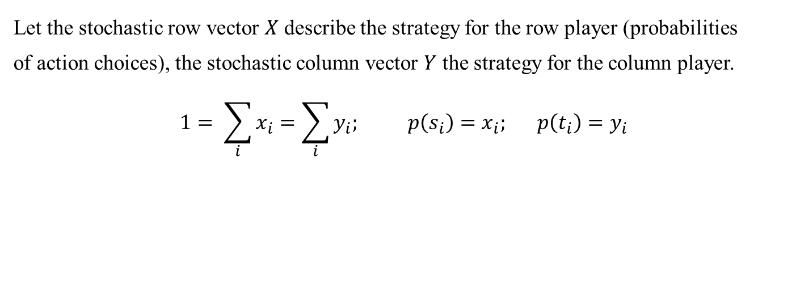
Expected Payoff (Utility)
If we adopt a mixed strategy (a set of strategy for alternating use) instead of a pure strategy (a single strategy), each individual game must choose their actions randomly (according to the distribution) in order to be unpredictable.
Let the stochastic row vector $X$ describe the strategy for the row player (probabilities of action choices), the stochastic column vector $Y$ the strategy for the column player.
$$1= \sum_{i}{x_{i}=\sum_{i}{y_{i}; p\left(s_{i}\right)=x_{i}; p\left(t_{i}\right)=y_{i}}}$$
The expected average pay-off (per round) in an iterated game for payoff matrix $A = [a_{ij}]$is
$$\sum_{i=1}^{n}{\sum_{j=1}^{m}{a_{i,j} . x_{i} . y_{j}=XAY}}$$
FIT5226-S2-2024
26/46
Notes:
XAY in matrix form = (1 x n) (n x m) (m x 1) = (1 x 1)

Slide 27
Mixed Nash
Best response and Nash equilibrium generalise from actions to strategies:
Best response: s_{i}* ∈ BR(s_{−i}) iﬀ ∀s_{i} ∈ S_{i}, u_{i}(s_{i}*, s_{−i}) ≥ u_{i}(s_{i}, s_{−i})
Nash: s = ⟨s₁, …, s_{n}⟩$ is a Nash equilibrium iﬀ ∀i, s_{i} ∈ BR(s_{−i})
FIT5226-S2-2024
27/46
Notes:
The concept of best response and Nash equilibrium in mixed strategies generalizes from actions to strategies as follows:
Best response (BR): A strategy $s_{i}^{∗}$ is a best response to the strategies of others $s_{−i}$ if it gives the highest possible utility for player $i$, compared to any other strategy $s_{i}$​.
Nash equilibrium: A strategy profile $⟨s_{1},…,s_{n}⟩$is a Nash equilibrium if, for every player iii, their strategy $s_{i}$​ is a best response to the strategies of the other players $s_{−i​}$.

Slide 28
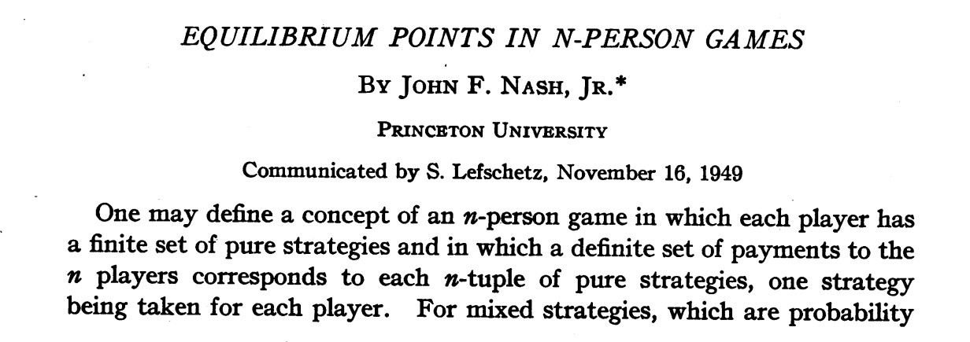

Every game with a finite number of pure strategies has at least one
Nash Equilibrium in (possibly) mixed strategies.
FIT5226-S2-2024
28/46
Notes:
According to Nash's Theorem, every game with a finite number of pure strategies has at least one Nash equilibrium in (possibly) mixed strategies. This means that even if there is no Nash equilibrium in pure strategies, there is always a Nash equilibrium in mixed strategies, where players randomize over their available actions. This guarantees that in finite games, there will be some equilibrium point where no player has an incentive to deviate from their chosen strategy.

Slide 29
Finding Nash
FIT5226-S2-2024
29/46

Slide 30
Finding Nash (Example)
B F
B
F
2, 1 | 0, 0
0, 0 | 1, 2
The "support" refers to the set of strategies within a player's mixed strategy that have non-zero probabilities of being chosen.
Computing Nash equilibria is easy when you can guess the support
For BoS, let’s look for an equilibrium where all actions are part of the support
FIT5226-S2-2024
30/46
Notes:
BoS: Battle of Sexes
The "support" refers to the set of strategies within a player's mixed strategy that have non-zero probabilities of being chosen. It essentially represents the subset of a player's mixed strategy that is actively being used or "supported" in the game.

Slide 31
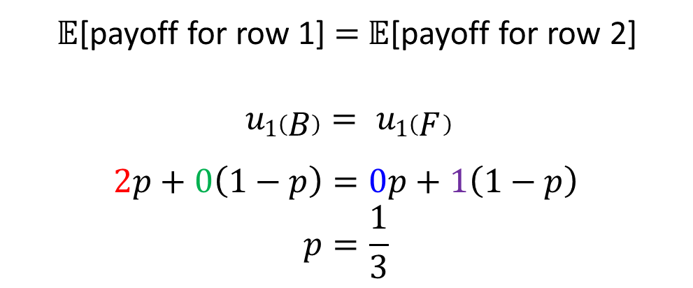
Finding Nash (Example)
B F
$𝔼$[payoff for row 1] $=$ $𝔼$[payoff for row 2]
$$u1\left(B\right)= u1\left(F \right)$$
$$2p+0\left(1−p\right)=0p+1\left(1−p\right)$$
$$p=\frac{1}{3}$$
B
F
2, 1 | 0, 0
0, 0 | 1, 2
p
1 − p
Let player 2 (column) play B with p, F with 1 − p.
If player 1 best-responds with a mixed strategy,
player 2 must make him indifferent between B and F (why?)
no preference
FIT5226-S2-2024
31/46
Notes:
Indifferent: The players are making choices such that their opponents have no preference for one option over another

Slide 32
Finding Nash (Example)
B F
B
F
2, 1 | 0, 0
0, 0 | 1, 2
We get the result that in order to make Player 1 indifferent between his actions, Player 2 must choose B with probability 1/3 and F with probability 2/3.
Likewise, player 1 must randomize to make player 2 indifferent.
Why is player 1 willing to randomize?
FIT5226-S2-2024
32/46
Notes:
By a similar calculation it can be shown that to make Player 2 indifferent, Player 1 must choose B with probability 2/3 and F with probability 1/3.

Slide 33
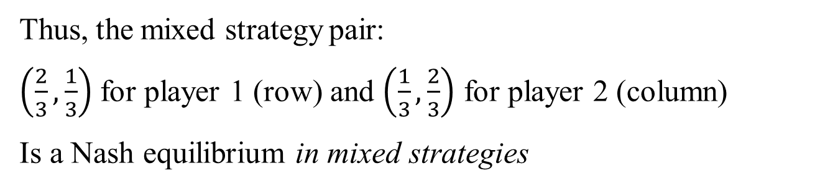

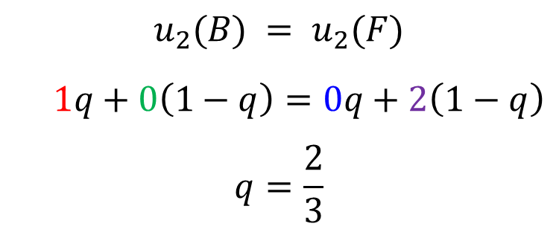
Finding Nash (Example)
B F
$𝔼$[payoff for col 1] $=$ $𝔼$[payoff for col 2]
$$u_{2}(B) = u_{2}(F)$$
$1q+0\left(1−q\right)=0q+2\left(1−q\right)$
$$q=\frac{2}{3}$$
B
F
2, 1 | 0, 0
0, 0 | 1, 2
Thus, the mixed strategy pair:
$\left(\frac{2}{3},\frac{1}{3}\right)$ for player 1 (row) and $\left(\frac{1}{3},\frac{2}{3}\right)$ for player 2 (column)
Is a Nash equilibrium in mixed strategies
FIT5226-S2-2024
33/46
Notes:
The computation of mixed Nash equilibria in extensive-form games is a computationally challenging problem, and it is considered NP-hard, which implies that it belongs to a class of problems that are at least as hard to solve as the hardest problems in NP (nondeterministic polynomial time) Expected Payoffs for Player 1 (Row):
Player 1's mixed strategy: $(\frac{2}{3},\frac{1}{3})$ Player 2's mixed strategy: $(\frac{1}{3},\frac{2}{3})$
If Player 1 plays B (Ballet):
Expected payoff $=\frac{1}{3}×2+\frac{2}{3}×0=\frac{2}{3}$
If Player 1 plays F (Football):
Expected payoff$=\frac{1}{3}×0+\frac{2}{3}×1=\frac{2}{3}$
Since both actions give the same expected payoff, Player 1 is indifferent between choosing B or F, and thus $(\frac{2}{3},\frac{1}{3})$ is a best response given Player 2's strategy.
Expected Payoffs for Player 2 (Column):
Player 1's mixed strategy: $(\frac{2}{3},\frac{1}{3})$ Player 2's mixed strategy: $(\frac{1}{3},\frac{2}{3})$
If Player 2 plays B (Ballet):
Expected payoff $=\frac{2}{3}×1+\frac{1}{3}×0=\frac{2}{3}​$
If Player 2 plays F (Football):
Expected payoff $=\frac{2}{3}×0+\frac{1}{3}×1=\frac{1}{3}​$
Given these expected payoffs, Player 2 prefers B over F but is willing to randomize according to $(\frac{1}{3},\frac{2}{3})$ to make Player 1 indifferent.
Conclusion:
The given mixed strategy pair $(\frac{2}{3},\frac{1}{3})$ for Player 1 and $(\frac{1}{3},\frac{2}{3})$ for Player 2 satisfies the Nash Equilibrium condition, as neither player can improve their expected payoff by unilaterally deviating from their strategy. Therefore, it is indeed a Nash Equilibrium in mixed strategies.

Slide 34
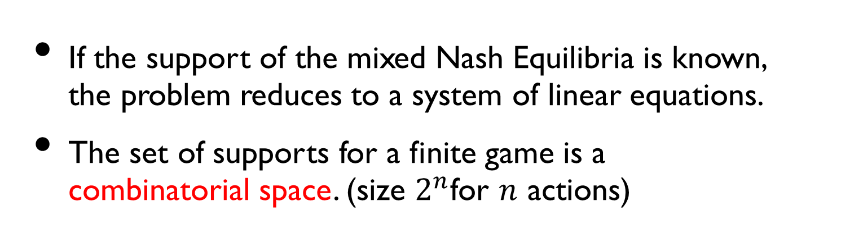
Finding mixed Nash in general
If the support of the mixed Nash Equilibria is known, the problem reduces to a system of linear equations.
The set of supports for a finite game is a combinatorial space. (size $2^{n}$for $n$ actions)
Finding mixed in general Nash Equilibria is a combinatorial problem.
FIT5226-S2-2024
34/46
Notes:
Nash Eq is computationally hard to find them. High time complexity. Support of Mixed Nash Equilibria:
The support of a mixed strategy refers to the set of actions that are played with positive probability.
If the support is known, the task of finding the MNE reduces to solving a system of linear equations because you only need to find the probabilities for the actions in the support.
Combinatorial Nature:
In a finite game with n actions, there are 2^n possible supports (since each action can either be in or out of the support).
Finding MNE is a combinatorial problem because you might need to explore many combinations of supports.
What If the Support is Unknown?
If the support is unknown, finding the MNE becomes much more complex because:
You have to explore all possible supports, which exponentially increases the problem's complexity.
For each possible support, you need to check if there exists a corresponding mixed strategy that satisfies the Nash Equilibrium conditions, which involves solving the linear equations for every potential support.

Slide 35

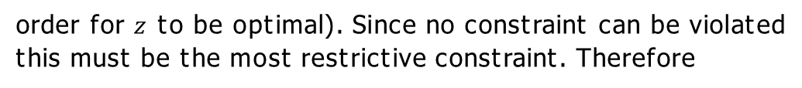

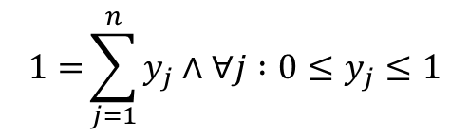

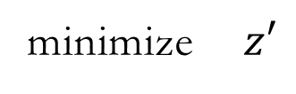
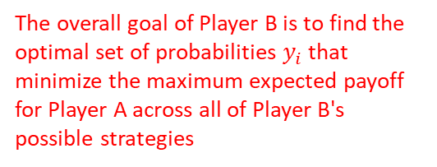
Solving 2-player 0-sum Games as Linear Programs
Find the optimal mixed strategy for Player B
$$\max_{i}{\sum_{j=1}^{n}{a_{i,j} . y_{j}}}$$
The task of player B (column) is to
minimize
$$1={\sum_{j=1}^{n}{y_{j}∧∀j :0≤y_{j}≤1}}$$
subject to
This is equivalent to the LP
minimize $z′$
and
$$\left\{\begin{aligned}∀i :z^{′}−\sum_{j=1}^{n}{a_{i,j} . y_{j}}≥0 \\ 1={\sum_{j=1}^{n}{y_{j}∧∀j :0≤y_{j}≤1}}\end{aligned}\right.$$
The overall goal of Player B is to find the optimal set of probabilities $y_{i}$ that minimize the maximum expected payoff for Player A across all of Player B's possible strategies
subject to
To prove this witness that for at least one i the first constraint in the LP must be tight (in
order for $z$ to be optimal). Since no constraint can be violated this must be the most restrictive constraint. Therefore
$$z=\max_{i}{\sum_{j=1}^{n}{a_{i,j} . y_{j}}}$$
FIT5226-S2-2024
35/46
Notes:
The 2-player zero-sum games is a special case where we can find Nash eq. in straightforward manner.
--------------------------------------------------------------
Solving a zero-sum game using linear programming, specifically in the context of finding the optimal mixed strategy for Player B (the column player) in a two-player zero-sum game. This linear programming formulation is used to calculate the Nash Equilibrium of such games.
The linear programming problem can be broken into:
Objective Function:
Objective: Player B (the column player) wants to minimize the maximum expected payoff that Player A (the row player) can achieve.
Objective Function: min $\max_{i}{\sum_{j=1}^{n}{a_{i,j} . y_{j}}}$
Here, $y_{j}$ represents the probability that Player B assigns to each of their pure strategies.
Constraints:
The constraints ensure that Player B's strategy is a valid probability distribution (i.e., probabilities sum to 1 and are non-negative):
$1=\sum_{j=1}^{n}{y_{j}}$: This constraint ensures that the probabilities assigned to all pure strategies sum to 1, meaning that Player B must choose a strategy with certainty.
$∀j :0≤y_{j}≤1$: These constraints ensure that the probabilities $y_{j}$ are non-negative and bounded between 0 and 1.
The overall goal of Player B is to find the optimal set of probabilities $y_{i}$ that minimize the maximum expected payoff for Player A across all of Player B's possible strategies. This corresponds to finding a Nash Equilibrium, where both players have no incentive to unilaterally change their strategies.
This linear programming formulation provides a systematic way to calculate Player B's optimal mixed strategy, which, when combined with Player A's strategy, defines a Nash Equilibrium in the zero-sum game.
--------------------------------------------------------------
Another way to express the linear programming (LP) problem used to find the optimal mixed strategy for Player B in a two-player zero-sum game. This formulation follows the same principles as the previous one, with slight differences in notation. Let's break down the components of this linear programming problem:
Objective Function:
Objective: Player B (the column player) wants to minimize a variable z'.
Objective Function: minimize z'
Constraints:
The constraints ensure that Player B's strategy is a valid probability distribution (i.e., probabilities sum to 1 and are non-negative) and that Player B's expected payoff is at least as good as the payoff Player A can achieve for each pure strategy:
For each pure strategy $i$ of Player B:
$z^{′}−\sum_{j=1}^{n}{a_{i,j} . y_{i}}≥0$: This constraint ensures that Player B's expected payoff (expressed as $\sum_{j=1}^{n}{a_{i,j} . y_{i}}$) is at least as good as the payoff Player A can achieve when both players use their respective mixed strategies.
$\sum_{j=1}^{n}{y_{i}}=1$: This constraint ensures that the probabilities assigned to all pure strategies sum to 1, meaning that Player B must choose a strategy with certainty.
$∀j :0≤y_{i}≤1$: These constraints ensure that the probabilities $y_{i}$ are non-negative and bounded between 0 and 1.
The overall goal of Player B is to find the optimal value of z' that minimizes z' while satisfying the constraints. This formulation allows Player B to choose a mixed strategy that minimizes their maximum expected loss (i.e., maximizing the minimum payoff for Player A).
Once again, this linear programming formulation provides a systematic way to calculate Player B's optimal mixed strategy, which, when combined with Player A's strategy, defines a Nash Equilibrium in the zero-sum game.

Slide 36
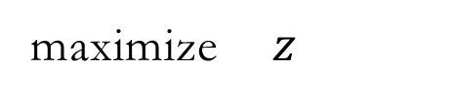

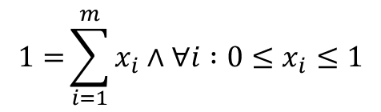

The Dual Role of Player A
With exactly the same (dual) reasoning (swapping minimization for maximization), Player A (the row player) arrives at the conclusion that
$$\max_{j}{\sum_{i=1}^{m}{a_{i,j} . x_{i}}}$$
Player A’s task is to
maximize
$$1={\sum_{i=1}^{m}{x_{i}∧∀i :0≤x_{i}}≤1}$$
subject to
which is equivalent to the LP
maximize $z$
$$\left\{\begin{aligned}∀j :z−\sum_{i=1}^{m}{a_{i,j} . x_{i}}≤0 \\ 1={\sum_{i=1}^{m}{x_{i}∧∀i :0≤x_{i}≤1}}\end{aligned}\right.$$
subject to
FIT5226-S2-2024
36/46

Slide 37

The MiniMax Theorem
For every m x n matrix A there is a stochastic row vector x-opt of length m and a stochastic column vector y-opt of length n such that
max_{X} XAY_{opt} = min_{Y} X_{opt} AY (equal payoff)
The original proof for that in the exclusive context of game theory is quite long and involved. After reduction to LP the proof has been much simplified by recasting it into the Duality Theory of linear programming.
Xopt and Yopt are therefore the strategies that the two players should adopt under the above reasoning. The common pay-off of these strategies is referred to as the “value” v of the game.
A can make a guaranteed win of $\$v$and B can protect themselves from losses greater than $v. It follows that the value of a fair game must be $v=0$.
A symmetric game $(−a_{ji} = a_{ij})$is always fair.
FIT5226-S2-2024
37/46
Notes:
The minimax theorem is a fundamental concept in game theory, particularly in two-player, zero-sum games. It is a fundamental theorem that helps determine optimal strategies for players in such games..
Two-Player, Zero-Sum Games: The minimax theorem is primarily applicable to two-player games in which one player's gain is the other player's loss. These are called zero-sum games because the sum of their payoffs is always zero. In other words, what one player gains, the other player loses, and vice versa.
Minimax Strategy: In a zero-sum game, the minimax strategy for a player is the strategy that minimizes the maximum possible loss. In other words, it's the strategy that ensures the player doesn't do worse than the worst-case scenario, assuming the opponent plays optimally to maximize their own gain.
The Minimax Theorem: The minimax theorem states that for every finite, two-player, zero-sum game with a finite number of strategies, there exists at least one mixed strategy (a probability distribution over pure strategies) for each player such that, when both players adopt their respective minimax strategies, they achieve a value called the minimax value.
Minimax Value: The minimax value represents the guaranteed minimum expected gain for one player and the maximum expected loss for the other player when both players follow their minimax strategies. It is a critical concept in zero-sum games as it defines the optimal outcome that both players can secure in a rational and risk-averse manner.
Optimal Play: The minimax theorem helps identify optimal strategies for both players in zero-sum games. Each player calculates their minimax strategy by considering the worst-case scenario, which the opponent would choose to maximize their own gain. By following these strategies, both players can ensure that they are playing as well as possible given their opponent's actions.
Solving Zero-Sum Games: To find the minimax value and strategies for a zero-sum game, one commonly used method is linear programming, specifically the simplex method. This approach allows for the computation of the minimax value and the corresponding strategies.
In summary, the minimax theorem is a central concept in game theory that provides a rational and risk-averse approach for players to determine their strategies in two-player, zero-sum games. It ensures that both players are making choices that minimize their maximum possible loss, leading to stable and well-defined outcomes.

Slide 38
Unexpected Conclusion
Corollary (Gloating):
In a game of the above type your opponent can gain nothing from you announcing your strategy if it is optimal.
You can announce your strategy without damaging your prospects.
Homework: Contemplate the rational value of bluffing.
FIT5226-S2-2024
38/46

Slide 39
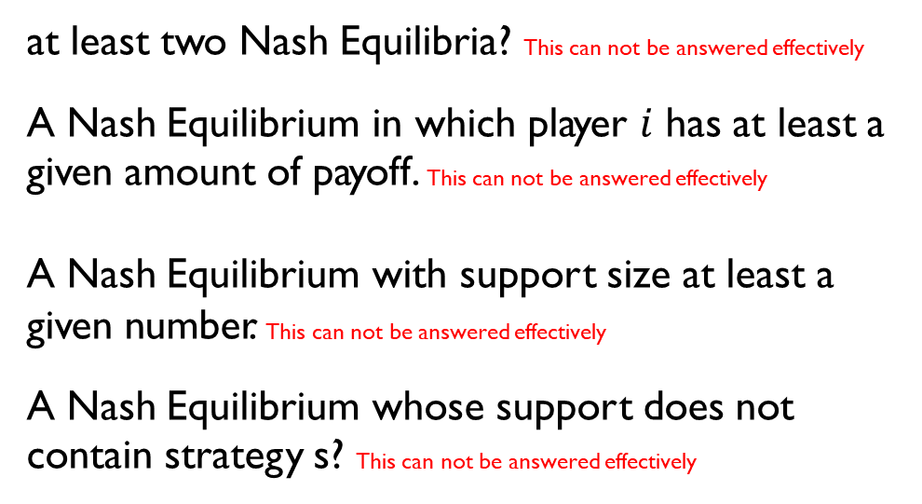
•
The following are NP-complete problems. Given a bi-matrix game, does it have…
•
•
•
•
at least two Nash Equilibria? This can not be answered effectively
A Nash Equilibrium in which player $i$ has at least a given amount of payoff. This can not be answered effectively
A Nash Equilibrium with support size at least a given number. This can not be answered effectively
A Nash Equilibrium whose support does not contain strategy s? This can not be answered effectively
“Algorithmic Game Theory”, Nissan et al (2007).
FIT5226-S2-2024
39/46
Notes:
At least two Nash Equilibria?
This problem is not known to be NP-complete. Determining if a bi-matrix game has at least two Nash equilibria can typically be done in polynomial time using algorithms such as Lemke-Howson or Lemke's algorithm. The complexity of finding multiple Nash equilibria is not well-understood, but it is not known to be NP-complete.
A Nash Equilibrium in which player 1 has at least a given amount of payoff?
This problem is NP-complete. It is known as the "Nash Equilibrium with a Minimum Payoff" problem and is proven to be NP-complete because it is essentially a variation of the computational problem "PPAD-complete."
A Nash Equilibrium with support size at least a given number?
This problem is not known to be NP-complete. Finding a Nash equilibrium with a specific support size can often be accomplished through polynomial-time algorithms that iteratively check different subsets of strategies, and it doesn't inherently exhibit NP-complete characteristics.
A Nash Equilibrium whose support does not contain strategy s?
This problem is not known to be NP-complete. Checking whether a Nash equilibrium exists in which a particular strategy is not used in the support of either player can be done efficiently without known NP-completeness.

Slide 40
The Price of Anarchy - or: Is Nash good?
The “Price of Anarchy” is the payoff lost due to the lack of central coordination.
For example, in the prisoners’ dilemma (below), central coordination would enable the prisoners to achieve -2 in total due to a lack of coordination they will only obtain -6 at Nash.
This “price of anarchy” is usually defined as the quotient of these quantities, here 2/6
C D
C
D
­-1, ­-1 | ­-4, 0
0, ­-4 | ­-3, ­-3
FIT5226-S2-2024
40/46
Notes:
The traditional definition of the Price of Anarchy (PoA) often looks at the worst-case scenario relative to the optimal coordinated outcome.
Here's how to align with the given definition of 2/6:
Identify Payoffs for Optimal Coordination and Nash Equilibrium:
Optimal Coordinated Outcome: Both players choose C, resulting in payoffs (-1, -1). The total payoff here is -2.
Nash Equilibrium: Both players choose D, resulting in payoffs (-3, -3). The total payoff here is -6.
Compute the Quotient for PoA: In this definition, it seems that the PoA is expressed as the ratio of the total payoff at the optimal coordinated outcome to the total payoff at the Nash equilibrium. This would be:
PoA=Total Payoff at Optimal Coordinated Outcome / Total Payoff at Nash Equilibrium=−2/−6 = 2 / 6

Slide 41
Self Study: Correlated Equilibrium
If there is intelligent life on other planets, in a majority of them, they would have discovered correlated equilibrium before Nash equilibrium.
– Roger Myerson
FIT5226-S2-2024
41/46
Notes:
A correlated equilibrium is a concept in game theory that extends the traditional notion of Nash equilibrium. While Nash equilibrium focuses on players making independent choices without any external coordination or communication, correlated equilibrium allows for some degree of communication and coordination among players before they make their decisions.
In other words, a correlated equilibrium provides a way for players to coordinate their actions based on external information or advice while still adhering to their self-interest. It represents a state in which no player has an incentive to unilaterally deviate from their recommended strategy, given the strategies suggested to others. In a sense, it's a way to achieve cooperation or coordination in a game without violating individual rationality.
Correlated equilibria are especially relevant in situations where communication or coordination among players is possible, or when there is a trusted mediator who can provide recommendations. They provide a broader framework for analyzing strategic interactions beyond traditional Nash equilibria, which assume no communication or pre-play coordination.

Slide 42

Self Study: Correlated Equilibrium (Example 1: BoS)
B F
B
F
The ideal fair outcome is to play B/F equally often $\left(\frac{1}{2}.\frac{1}{2}\right)$
There is no way to achieve this. Players may and will miscoordinate!
2, 1 | 0, 0
0, 0 | 1, 2
FIT5226-S2-2024
42/46
Notes:
In the Battle of the Sexes game that you provided, let's consider the concept of correlated equilibrium. In this game, there are two players, Wife and Husband, and each has two strategies: B (Bayley) and F (Football). We'll explore a simple correlated equilibrium example.
Suppose there is a trusted mediator who can suggest a correlated strategy to both players. The correlated strategy suggests that both players should choose their preferred activities (B or F) with equal probability, meaning they both choose B with probability 0.5 and F with probability 0.5.
Here's how this correlated equilibrium works:
The mediator suggests to both the Wife and the Husband to choose B with a probability of 0.5 and F with a probability of 0.5.
The Wife and the Husband receive these recommendations independently.
Each player follows the recommended strategy with the probabilities suggested by the mediator.
In this correlated equilibrium:
The Wife has a 0.5 probability of getting a payoff of 2 (when both choose B) and a 0.5 probability of getting a payoff of 0 (when both choose F).
The Husband also has a 0.5 probability of getting a payoff of 2 (when both choose F) and a 0.5 probability of getting a payoff of 0 (when both choose B).
No player has an incentive to deviate from this strategy because, given the correlated strategy, they are maximizing their expected payoff based on their preferences. In other words, both players are better off following the recommendations than unilaterally changing their strategy.
This example illustrates how a correlated equilibrium can be used to coordinate actions in a game where players have conflicting interests and no pure Nash equilibrium represents a satisfactory outcome for both players. The correlated equilibrium, in this case, ensures that both players have a chance to achieve their preferred outcomes with equal probabilities.

Slide 43
Self Study: Correlated Equilibrium (Example 2: Traffic)
Go Stop
Go
Stop
-10, -10 | 1, 0
0, 1 | -1, -1
Shouldn’t we have a traffic light?
The traffic light could also be random!
a fair random variable with a commonly known distribution,
and a private signal to each player about the outcome is sufficient!
signal doesn’t determine the outcome or others’ signals;
it correlates them
FIT5226-S2-2024
43/46

Slide 44
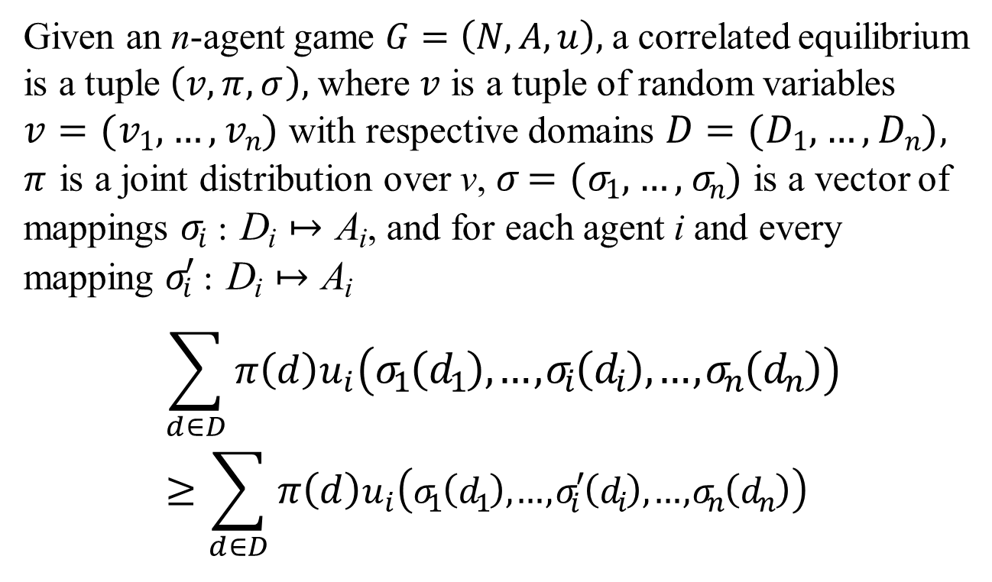
Self Study: Correlated Equilibrium (Def)
Given an n-agent game $G=\left(N, A, u\right),$a correlated equilibrium is a tuple $\left(v, π, σ\right),$where $v$ is a tuple of random variables $v=(v1, …, vn)$with respective domains $D=(D1, …, Dn),$ $π$ is a joint distribution over v, $σ=(σ1, …, σn)$is a vector of mappings $σi$: D_{i} ↦ A_{i}, and for each agent i and every mapping $σi′$: D_{i} ↦ A_{i}
$$\sum_{d∈D}{π\left(d\right)u_{i}\left(σ_{1}\left(d_{1}\right), …,σ_{i}\left(d_{i}\right), …,σ_{n}\left(d_{n}\right)\right)} \\ ≥\sum_{d∈D}{π\left(d\right)u_{i}\left(σ_{1}\left(d_{1}\right), …,σ_{i}^{′}\left(d_{i}\right), …,σ_{n}\left(d_{n}\right)\right)}$$
Refer to Section 3.4.5 (Multiagent Systems Book)
FIT5226-S2-2024
44/46
Notes:
The definition describes a correlated equilibrium in a general n-agent game. Let's break down the components of this definition:
n-agent Game 𝐺=(𝑁, 𝐴, 𝑢):
𝑁: The set of agents (players) involved in the game.
𝐴: The set of action profiles, where each agent can choose an action from their respective action set.
𝑢: The utility function that maps action profiles to payoffs for each agent, indicating how each agent's payoff depends on the chosen actions of all agents.
Correlated Equilibrium Tuple (𝑣, 𝜋, 𝜎):
𝑣: A tuple of random variables 𝑣=(𝑣1, ..., 𝑣𝑛), where each 𝑣𝑖 is associated with an agent i and has a domain 𝐷𝑖. These random variables represent uncertain or probabilistic outcomes or signals related to the agents' decisions.
𝜋: A joint distribution over the random variables 𝑣. It specifies the probabilities associated with different combinations of outcomes for the agents.
𝜎: A vector of mappings 𝜎=(𝜎1, ..., 𝜎𝑛), where each 𝜎𝑖 is a mapping from the domain 𝐷𝑖 of agent i's random variable 𝑣𝑖 to the action set Ai for that agent.
𝜎𝑖 : Di ↦ Ai: Each mapping 𝜎𝑖 defines how agent i's chosen action (from set Ai) depends on the outcome of their random variable 𝑣𝑖, which takes values from domain Di. In other words, 𝜎𝑖 maps the possible outcomes of 𝑣𝑖 to the actions the agent can take.
The concept of a correlated equilibrium allows for a broader range of strategic interactions than traditional Nash equilibria. It permits agents to consider probabilistic or correlated strategies, where the actions they take depend on random variables or signals. The joint distribution 𝜋 specifies how these random variables interact to determine the agents' actions, and 𝜎 maps the outcomes of these variables to actual actions.
In a correlated equilibrium, no agent has an incentive to unilaterally deviate from their prescribed strategy given the outcome of their random variable and the correlated strategy specified by 𝜋. It represents a way to capture strategic coordination and correlated behavior among agents in a game.

Slide 45
Self Study: Existence
For every Nash equilibrium there exists a corresponding correlated equilibrium
Proof as an exercise
Not every correlated equilibrium is equivalent to a Nash equilibrium. Thus correlated equilibrium is a weaker notion than Nash.
FIT5226-S2-2024
45/46

Slide 46
Self Study: Take home lessons
•
The core difficulty with finding the optimal strategy is that desirable actions depend on the actions of other players. We thus have circular dependencies.
•
If a player knew the actions of all other players (and the payoff structure), they could simply choose a “best response.”
•
A stable outcome would be if every player plays the best response to all other players.
•
This is called the Nash equilibrium. It constitutes a situation where no player has an incentive to deviate unilaterally from the combination of strategies being played.
•
Alternative equilibrium definition (e.g. correlated equilibrium) exist
•
Nash equilibria can be defined for pure strategies (single action) or mixed strategies (probability distributions over actions)
•
Determining Nash equilibria is generally computationally hard.
•
For 2-player zero-sum games they can be computed efficiently as linear programs.
•
This is based on the MiniMax theorem, which can be understood as a corollary of the Duality Theorem of linear programming (even though historically it isn’t).
FIT5226-S2-2024
Week-7
46/46

